Slide 1
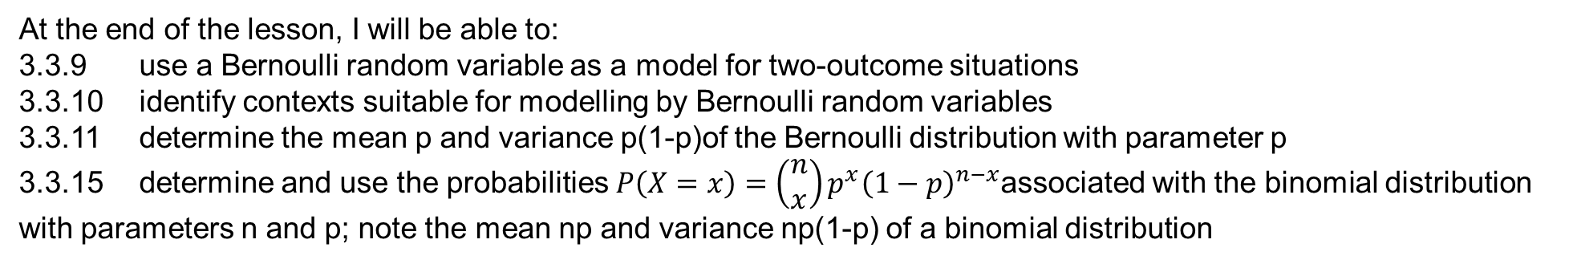
Learning Objective
I will be able to determine the mean and variance of Bernoulli sequences and binomial probability distribution
Success Criteria
At the end of the lesson, I will be able to:
3.3.9 use a Bernoulli random variable as a model for two-outcome situations
3.3.10 identify contexts suitable for modelling by Bernoulli random variables
3.3.11 determine the mean p and variance p(1-p)of the Bernoulli distribution with parameter p
3.3.15 determine and use the probabilities $P\left(X=x\right)=\left(\begin{matrix}n \\ x\end{matrix}\right)p^{x}{\left(1−p\right)}^{n−x}$associated with the binomial distribution with parameters n and p; note the mean np and variance np(1-p) of a binomial distribution

Slide 2
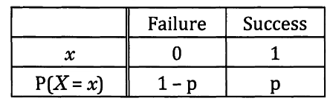
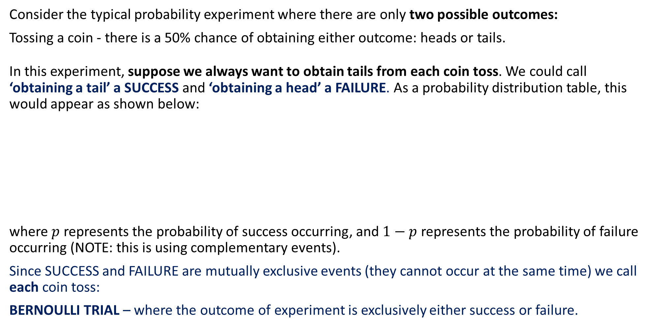
Bernoulli Trials
Consider the typical probability experiment where there are only two possible outcomes:
Tossing a coin - there is a 50% chance of obtaining either outcome: heads or tails.
In this experiment, suppose we always want to obtain tails from each coin toss. We could call ‘obtaining a tail’ a SUCCESS and ‘obtaining a head’ a FAILURE. As a probability distribution table, this would appear as shown below:
where $p$ represents the probability of success occurring, and $1−p$ represents the probability of failure occurring (NOTE: this is using complementary events).
Since SUCCESS and FAILURE are mutually exclusive events (they cannot occur at the same time) we call each coin toss:
BERNOULLI TRIAL – where the outcome of experiment is exclusively either success or failure.

Slide 3
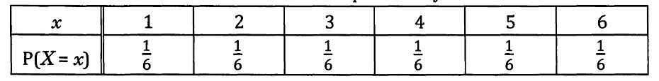
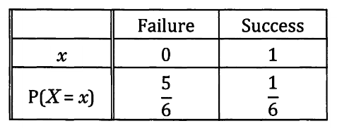
Representing Distributions as ‘SUCCESS’ or ‘FAILURE’ Situations
Not all experiments are immediately SUCCESS or FAILURE scenarios, such as rolling a six-sided die.
Each outcome is equally likely, but not exclusively limited to two events.
However, if we reconsider the scenario in terms of ‘getting a six’ and ‘not getting a six’ (i.e. a success and failure situation of obtaining a six on a die), we have a Bernoulli random variable with the following probability distribution:

Slide 4
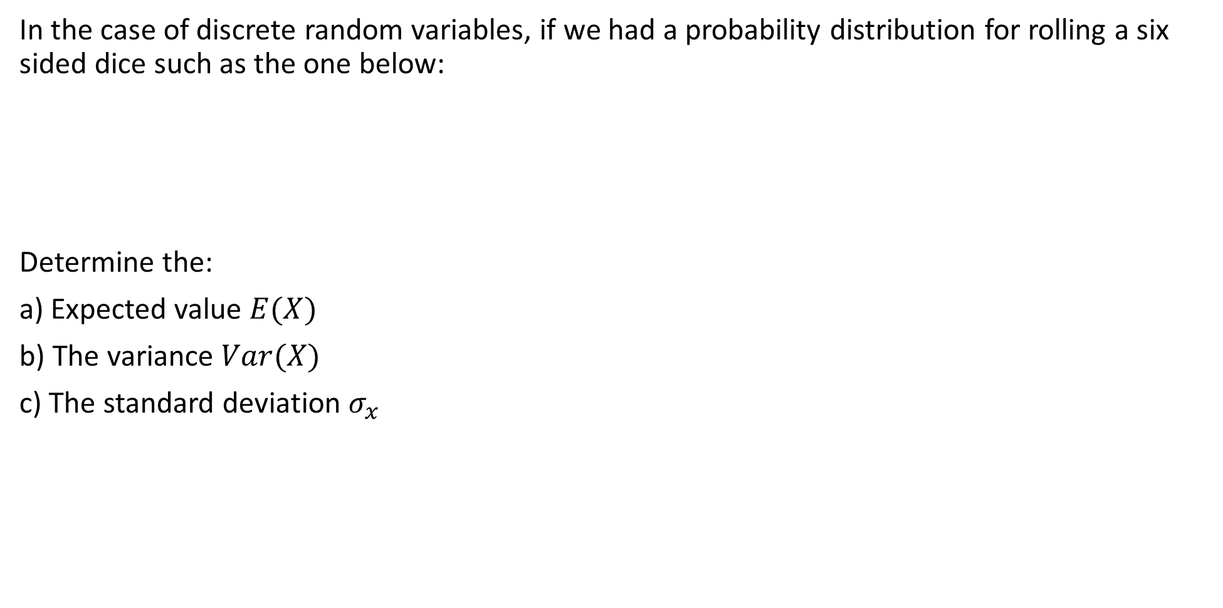
REVIEW: Calculating Expected Value, Variance and S.D.
In the case of discrete random variables, if we had a probability distribution for rolling a six sided dice such as the one below:
Determine the:
a) Expected value $E(X)$
b) The variance $Var(X)$
c) The standard deviation $σ_{x}$
x | 1 | 2 | 3 | 4 | 5 | 6
P(X = x) | $$\frac{1}{6}$$ | $$\frac{1}{6}$$ | $$\frac{1}{6}$$ | $$\frac{1}{6}$$ | $$\frac{1}{6}$$ | $$\frac{1}{6}$$

Slide 5
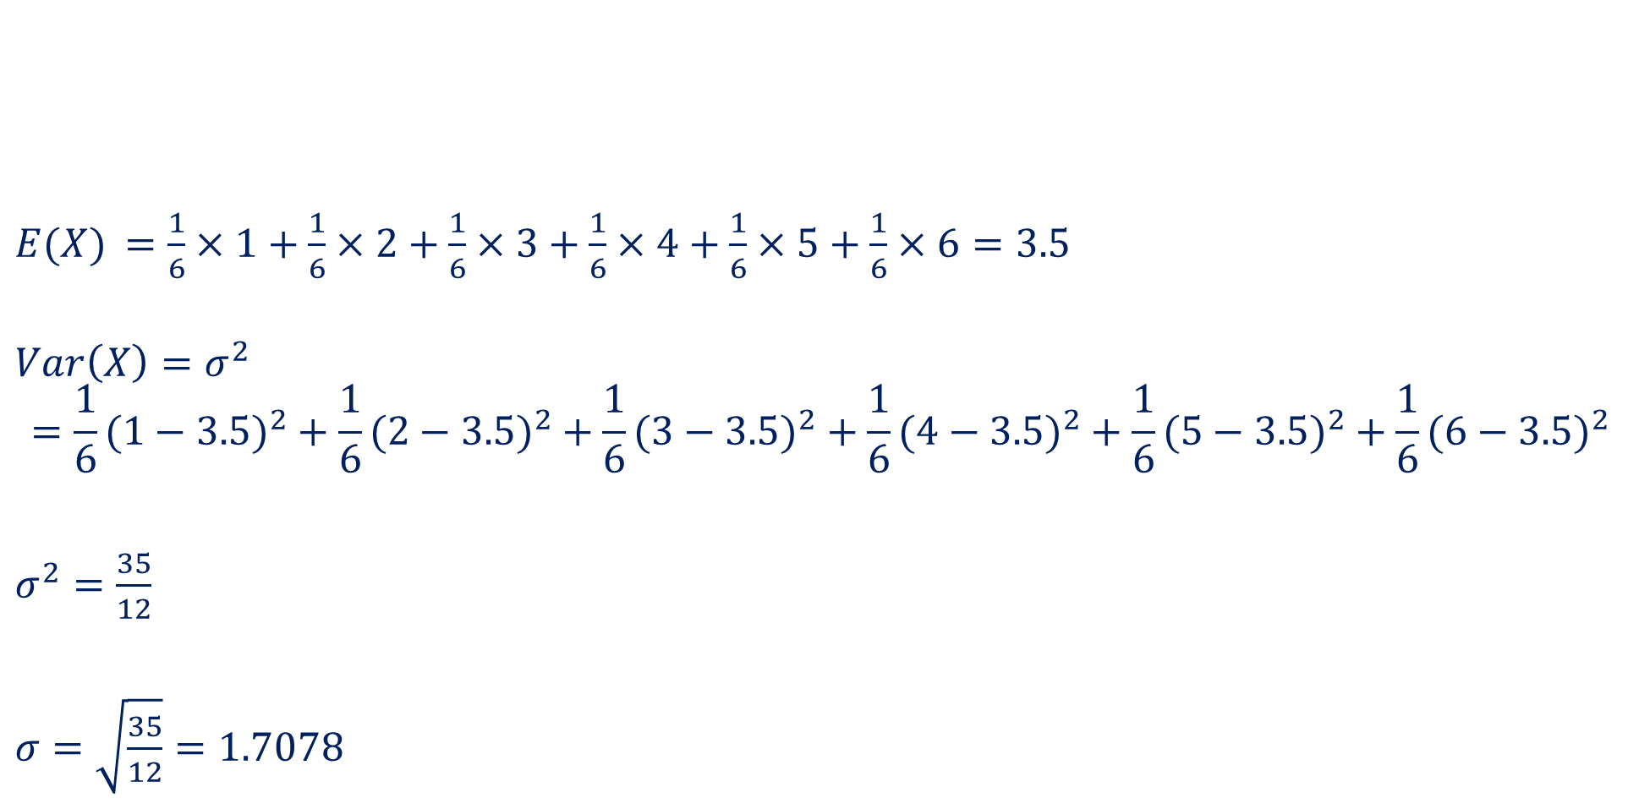
REVIEW: Calculating Expected Value, Variance and S.D.
$E(X)$ $=\frac{1}{6}×1+\frac{1}{6}×2+\frac{1}{6}×3+\frac{1}{6}×4+\frac{1}{6}×5+\frac{1}{6}×6=3.5$
$$Var\left(X\right)=σ^{2}$$
$$=\frac{1}{6}(1−3.5)^{2}+\frac{1}{6}(2−3.5)^{2}+\frac{1}{6}(3−3.5)^{2}+\frac{1}{6}(4−3.5)^{2}+\frac{1}{6}(5−3.5)^{2}+\frac{1}{6}(6−3.5)^{2}$$
$σ^{2}=\frac{35}{12}$
$σ=\sqrt{\frac{35}{12}}=1.7078$
x | 1 | 2 | 3 | 4 | 5 | 6
P(X = x) | $$\frac{1}{6}$$ | $$\frac{1}{6}$$ | $$\frac{1}{6}$$ | $$\frac{1}{6}$$ | $$\frac{1}{6}$$ | $$\frac{1}{6}$$

Slide 6
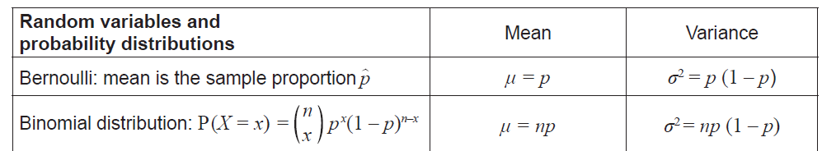
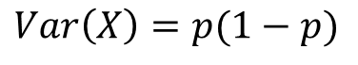
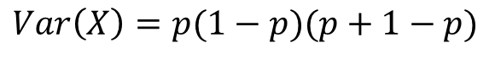
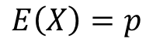
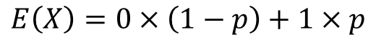

Expected Value and Variance in Bernoulli Trials
Using the same principles for calculating expected value and variance, determine the mean/expected value and variance for a Bernoulli experiment.
$$E\left(X\right)=0×\left(1−p\right)+1×p$$
$$E\left(X\right)=p$$
$$Var\left(X\right)={\left(0−p\right)}^{2}×\left(1−p\right)+{\left(1−p\right)}^{2}×p$$
$$Var\left(X\right)=p(1−p)(p+1−p)$$
$$Var\left(X\right)=p(1−p)$$
$∴$for a Bernoulli distribution,
$$E\left(X\right)=p \\ Var\left(X\right)=p(1−p)$$

Slide 7
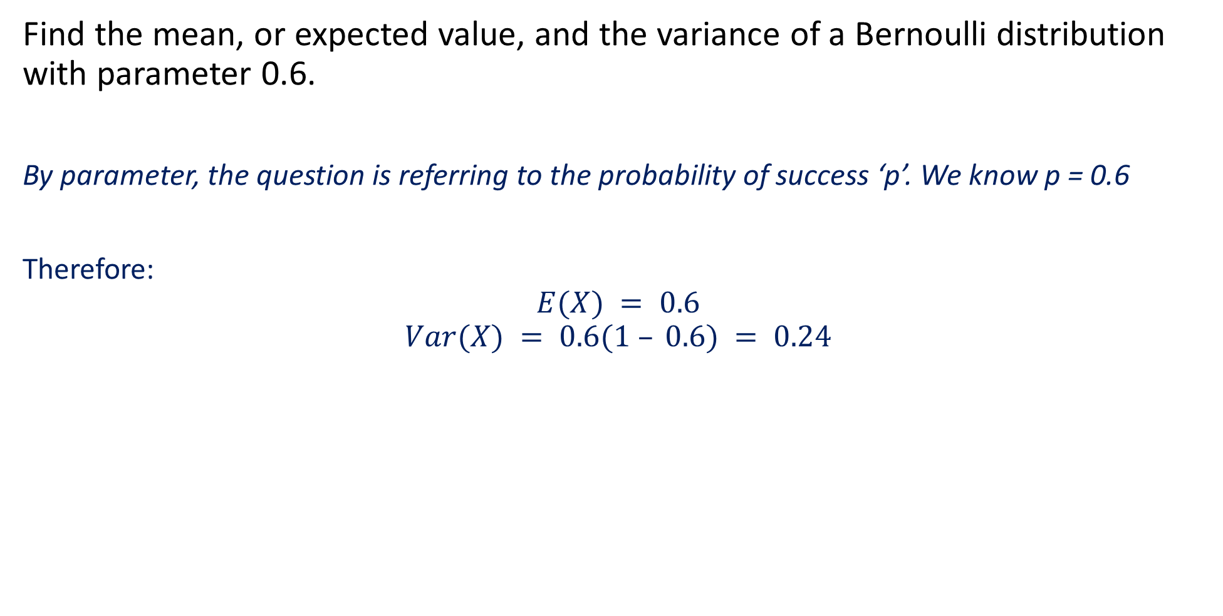
Guided Practice
Find the mean, or expected value, and the variance of a Bernoulli distribution with parameter 0.6.
By parameter, the question is referring to the probability of success ‘p’. We know p = 0.6
Therefore:
$$E(X) = 0.6$$
$$Var(X) = 0.6(1 – 0.6) = 0.24$$

Slide 8
Binomial Distributions
BERNOULLI distributions involve a SINGLE trial of a success/failure experiment.
BINOMIAL distributions (Cambridge uses Bernoulli sequence – replace this with Binomial distribution) involve MULTIPLE trials of a success/failure experiment (i.e. we repeat the Bernoulli trials several times).
So a binomial distribution could involve:
Tossing a coin 100 times and observing the number of tails we obtain.
Rolling a six-sided die 50 times and observing the number of times we land on a one.
Sitting a multiple choice assessment with 25 questions and counting the number of times we obtain the correct answer.
Notice all these scenarios involve more than one coin toss, or one roll of die, or one question to answer. Therefore they are BINOMIAL.

Slide 9
Binomial Distributions
Binomial Distribution is followed when
Each trial results in only one of two outcomes, a success S or a failure F
The probability of success in a single trial occurs with a constant probability ‘p’,
Each trails are independent of each other – in other words, one outcome does not affect the next or previous outcomes.
Example: Justify why tossing a fair coin 10 times follows a Binomial Distribution?
There is only two possible outcomes – Success when we obtain a head, and failure when we do not
The probability of obtaining a head occurs with a constant probability of 0.5 for all trials.
Each coin toss is independent of the previous coin toss, the probability of obtaining either a head or a tail is unaffected by the previous or following outcomes.

Slide 10
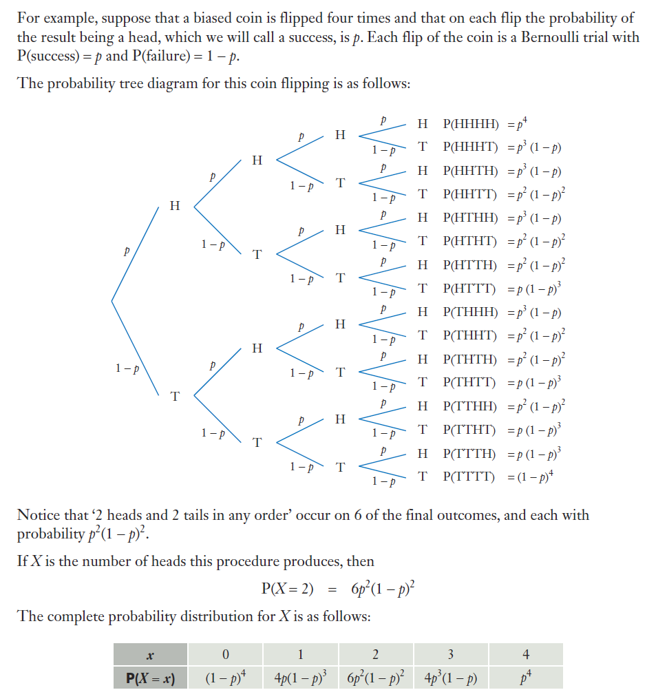
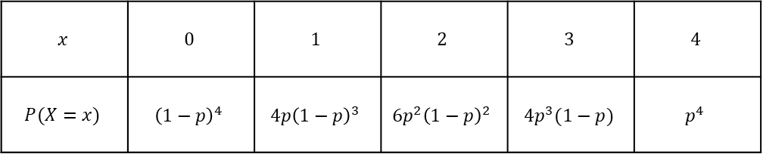
Binomial Distributions
For example, if a bias coin is flipped 4 times. The probability the result being a HEAD, we will call a success P(success) = p and P(failure) = 1-p
Draw a probability tree diagram
Let X be the number of heads (number of success). Complete the probability distribution table for X.
$$x$$ | $$0$$ | $$1$$ | $$2$$ | $$3$$ | $$4$$
$$P(X=x)$$ | $${\left(1−p\right)}^{4}$$ | $$4p{\left(1−p\right)}^{3}$$ | $$6p^{2}{\left(1−p\right)}^{2}$$ | $$4p^{3}(1−p)$$ | $$p^{4}$$

Slide 11
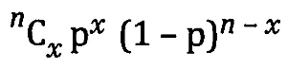
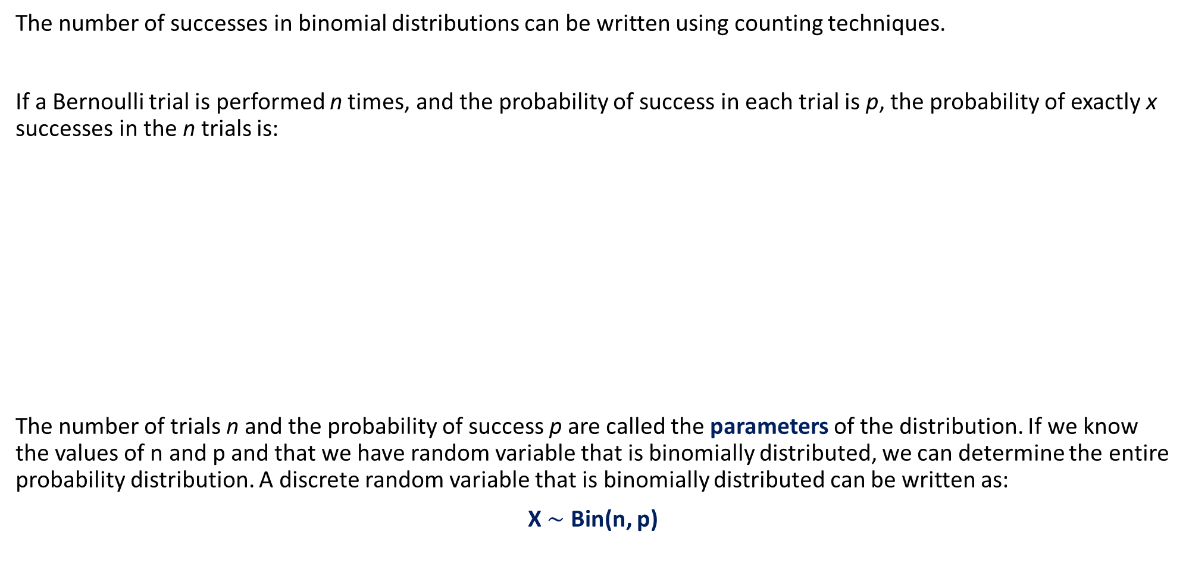
Binomial Distributions
The number of successes in binomial distributions can be written using counting techniques.
If a Bernoulli trial is performed n times, and the probability of success in each trial is p, the probability of exactly x successes in the n trials is:
The number of trials n and the probability of success p are called the parameters of the distribution. If we know the values of n and p and that we have random variable that is binomially distributed, we can determine the entire probability distribution. A discrete random variable that is binomially distributed can be written as:
X $\sim$ Bin(n, p)
The number of ways x successes can be chosen
out of the n trials
The number of times the chances of x successes occurs in n trials
The number of times the chances of failure occurs in n trials if x successes occurs

Slide 12
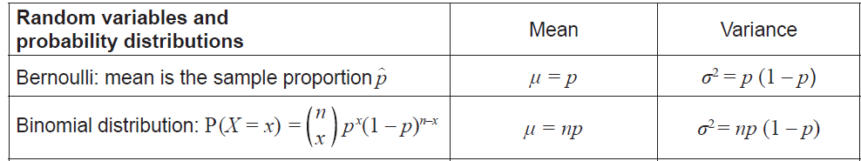
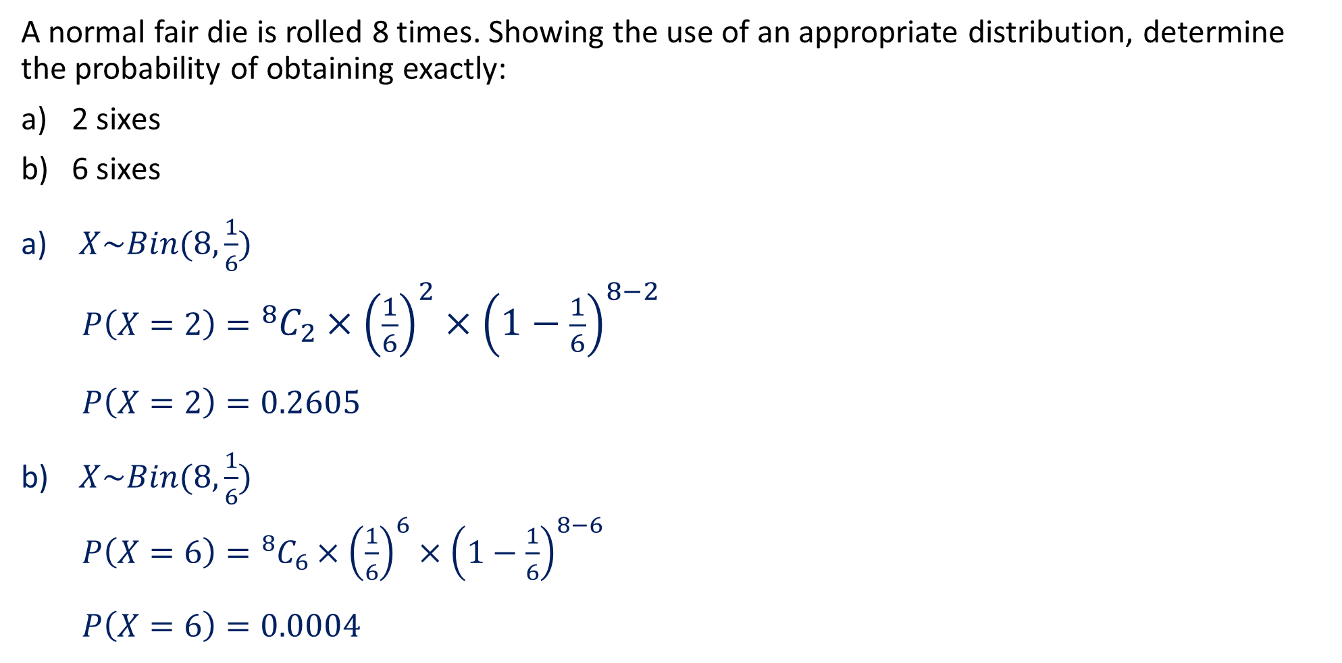
Guided Practice
A normal fair die is rolled 8 times. Showing the use of an appropriate distribution, determine the probability of obtaining exactly:
2 sixes
6 sixes
$X\sim Bin(8, \frac{1}{6})$
$P\left(X=2\right)={}_{ }^{8}{C_{2}}×{\left(\frac{1}{6}\right)}^{2}×{\left(1−\frac{1}{6}\right)}^{8−2}$
$P\left(X=2\right)=0.2605$
$X\sim Bin(8, \frac{1}{6})$
$P\left(X=6\right)={}_{ }^{8}{C_{6}}×{\left(\frac{1}{6}\right)}^{6}×{\left(1−\frac{1}{6}\right)}^{8−6}$
$P\left(X=6\right)=0.0004$

Slide 13
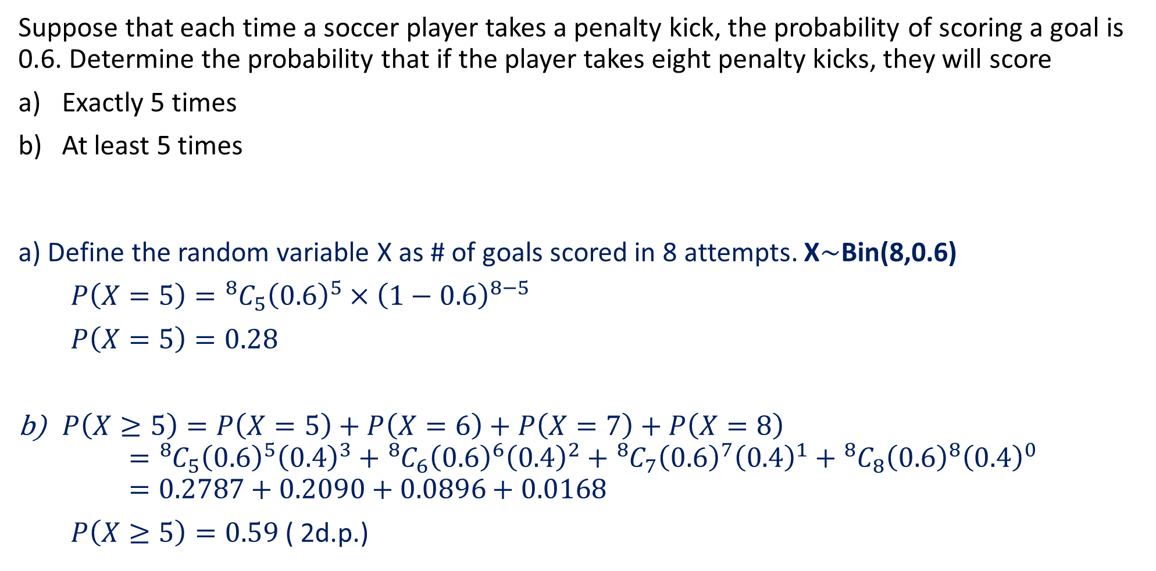
Guided Practice
Suppose that each time a soccer player takes a penalty kick, the probability of scoring a goal is 0.6. Determine the probability that if the player takes eight penalty kicks, they will score
Exactly 5 times
At least 5 times
a) Define the random variable X as # of goals scored in 8 attempts. X$\sim$Bin(8,0.6)
$P\left(X=5\right)={}_{ }^{8}{C_{5}}{\left(0.6\right)}^{5}×{\left(1−0.6\right)}^{8−5}$
$P\left(X=5\right)=0.28$
$P\left(X≥5\right)=P\left(X=5\right)+P\left(X=6\right)+P\left(X=7\right)+P\left(X=8\right)$ $={}_{ }^{8}{C_{5}}{\left(0.6\right)}^{5}{\left(0.4\right)}^{3}+{}_{ }^{8}{C_{6}}{\left(0.6\right)}^{6}{\left(0.4\right)}^{2}+{}_{ }^{8}{C_{7}}{\left(0.6\right)}^{7}{\left(0.4\right)}^{1}+{}_{ }^{8}{C_{8}}{\left(0.6\right)}^{8}{\left(0.4\right)}^{0}$ $=0.2787+0.2090+0.0896+0.0168$
$P\left(X≥5\right)=0.59$ ( 2d.p.)

Slide 14
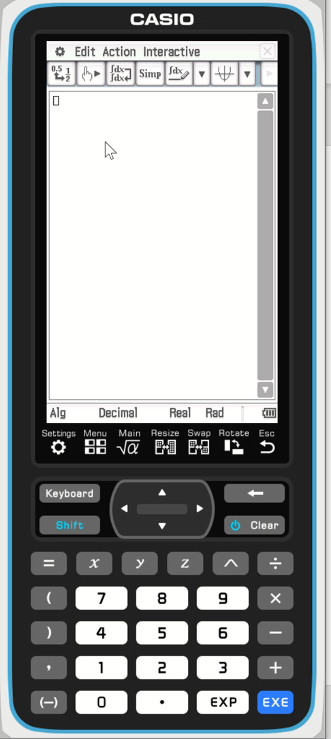
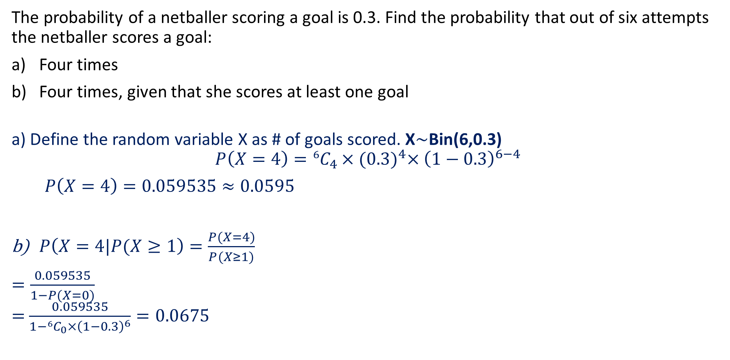
Guided Practice
The probability of a netballer scoring a goal is 0.3. Find the probability that out of six attempts the netballer scores a goal:
Four times
Four times, given that she scores at least one goal
a) Define the random variable X as # of goals scored. X$\sim$Bin(6,0.3)
$$P\left(X=4\right)={}_{ }^{6}{C_{4}}×{(0.3)}^{4}×{\left(1−0.3\right)}^{6−4}$$
$P\left(X=4\right)=0.059535≈0.0595$
$P\left(X=4|P(X≥1\right)=\frac{P(X=4)}{P(X≥1)}$
$=\frac{0.059535}{1−P(X=0)}$ $=$ $\frac{0.059535}{1−{}_{ }^{6}{C_{0}}×{\left(1−0.3\right)}^{6}}=0.0675$

Slide 15

Guided Practice
Each question of a multiple-choice test paper offers 5 answers, one of which is correct. A student answers 7 questions by simply guessing which response is correct each time.
Defining random variable X as how many of theses 7 questions the student gets correct, determine the complete probability distribution for X, giving probabilities correct to 3 d.p.
$$x$$ | $$0$$ | $$1$$ | $$2$$ | $$3$$ | $$4$$ | $$5$$ | $$6$$ | $$7$$
$$P(X=x)$$

Slide 16
Independent Practice
Complete Cambridge Ex 9A

